Slide 1
A Real Time Application to Identify Alcoholics from ECG Signals
Akarsh N Kolekar (1PI13EC009) Guide: Dr. b Niranjana Krupa
Apoorv Vatsal (1PI13EC017)
Rakshith Vishwanatha (1PI13EC075)

Slide 2
STATUS – since synopsis (21st Jan)
Raspberry Pi
Feature Extraction
Circuit Simulation
Classifier

Slide 3
RASPBERRY PI
Installed the OS
Enabled ssh to accessed terminal
Set static IP – cmdline.txt was used – IP and netmask provided

Slide 4
FEATURE EXTRATION
Time domain
Frequency domain
Non-linear techniques

Slide 5
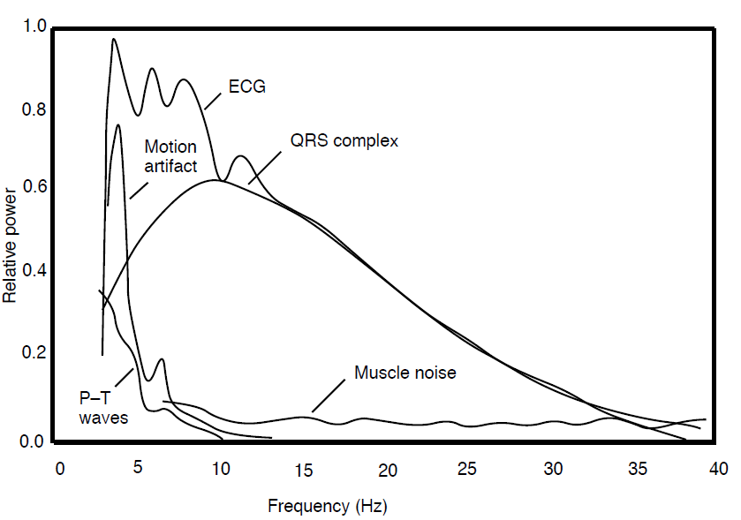
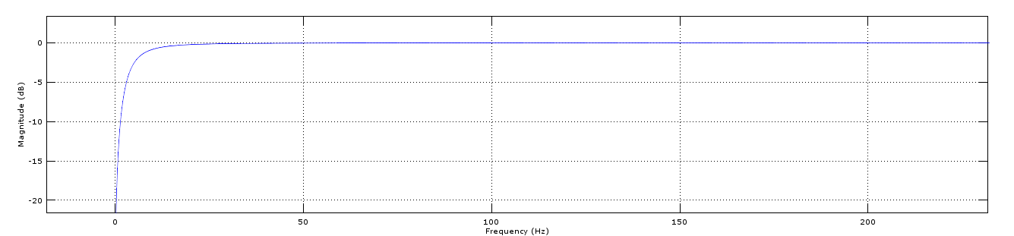
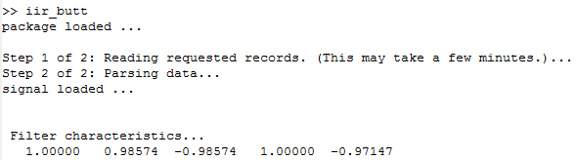
TIME DOMAIN
Based on PSD of generic ECG signal, an IIR HPF filter was designed to remove the low frequency baseline wandering

Slide 6
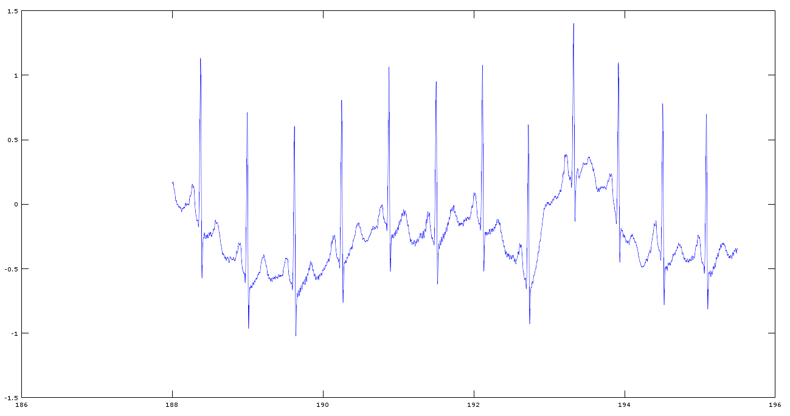
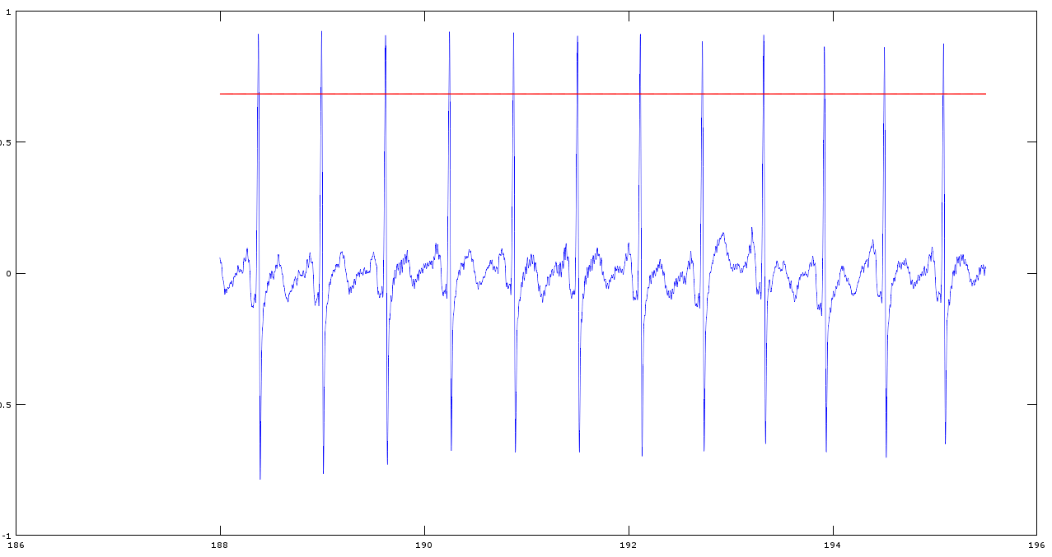

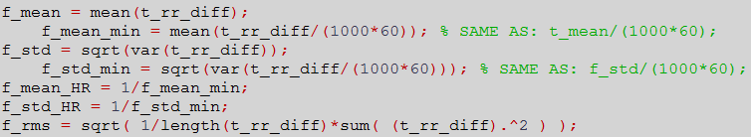
TIME DOMAIN

Slide 7
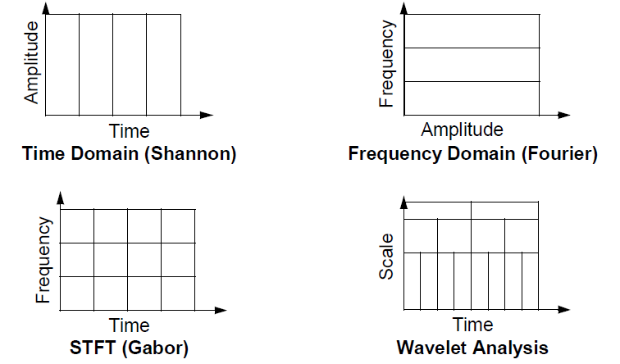
FREQUENCY DOMAIN
Techniques possible:
Fourier Analysis – time information is lost
Short Time Fourier Analysis – limited precision based on window size
Wavelet Transform

Slide 8
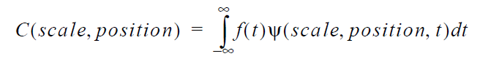
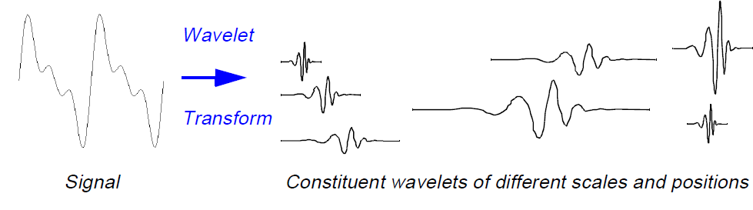
WHY WAVELET
Contains both frequency and time domain information
Splits parent signal to different freq components, allowing isolation of low frequency baseline wandering
R peak detection and RR interval calculation done

Slide 9
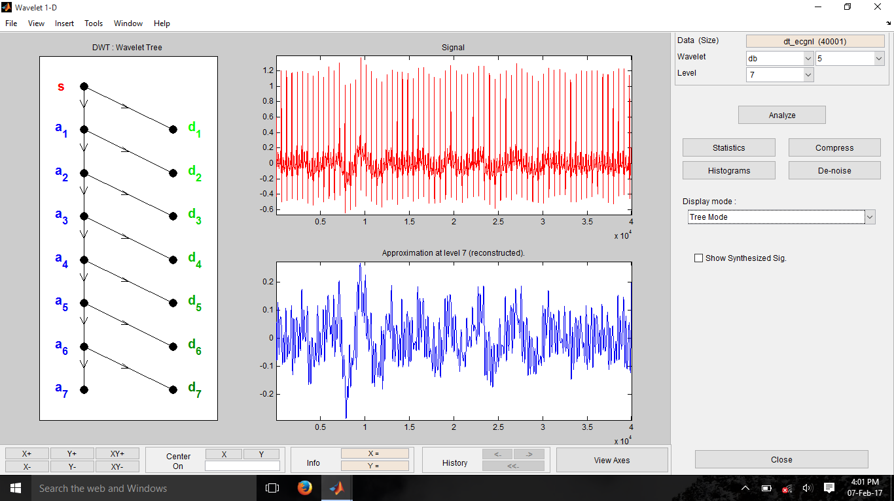
GRAPHS – MATLAB WAVELET TOOLBOX

Slide 10
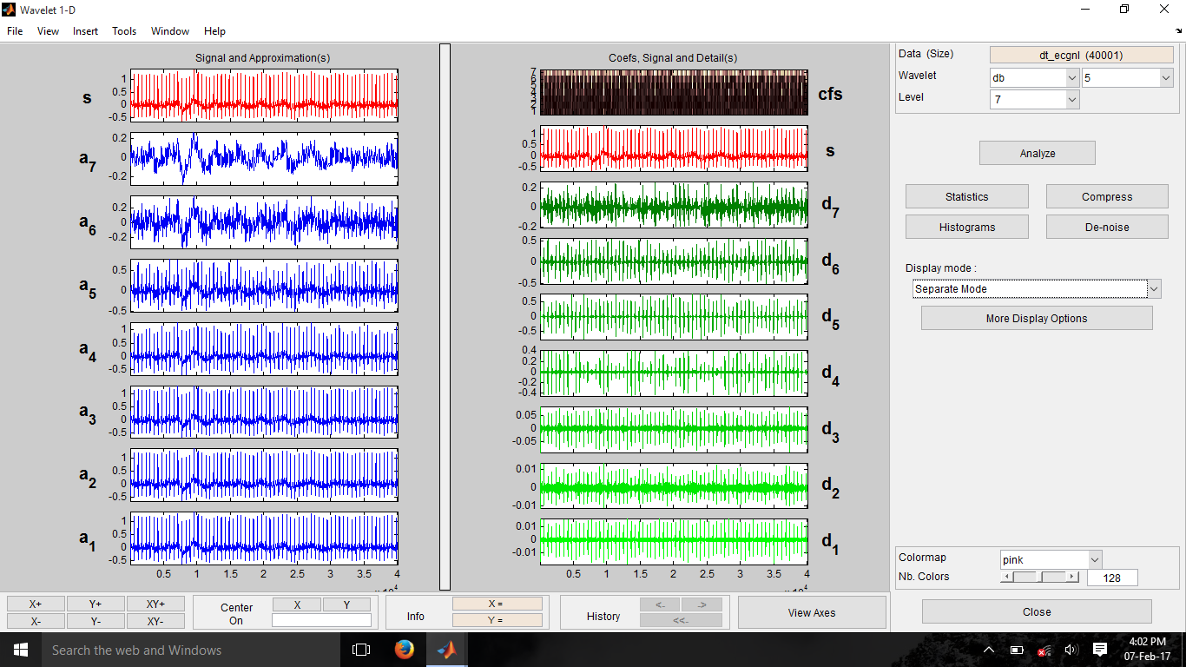
Wavelet Toolbox of Matlab
Daubechies (dB5) wavelet considered as mother wavelet
Scale level used was 7

Slide 11
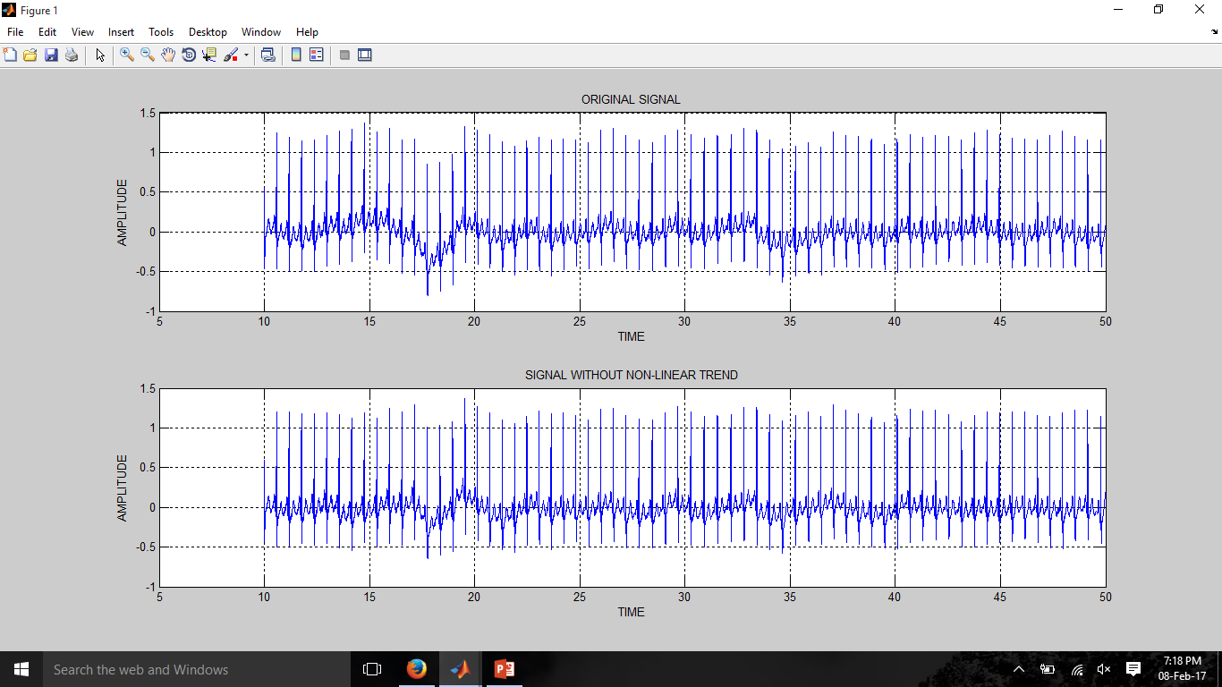
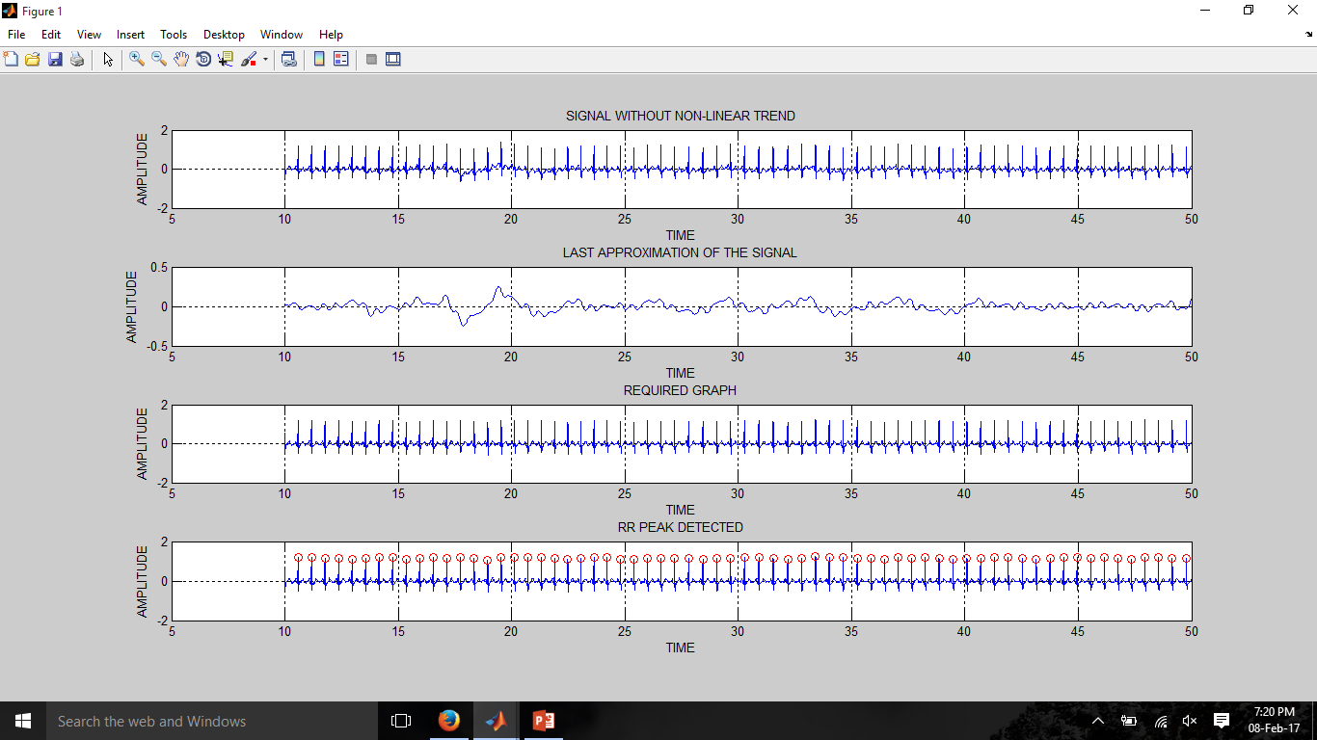
GRAPHS FOR ECG SAMPLE – MATLAB
Base line wandering removed using Wavelet transform

Slide 12
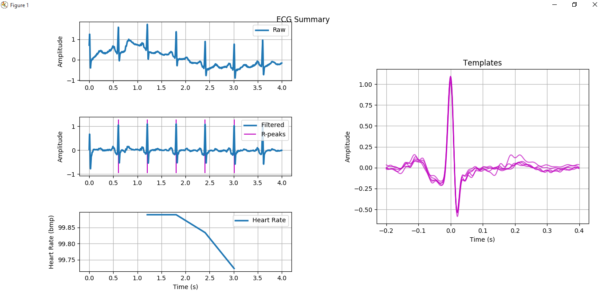
GRAPHS – PYTHON
De-trending the signal and RR peak detection was also implemented on Python
Notes:
Module used : biosppy,numpy and matplotlib

Slide 13
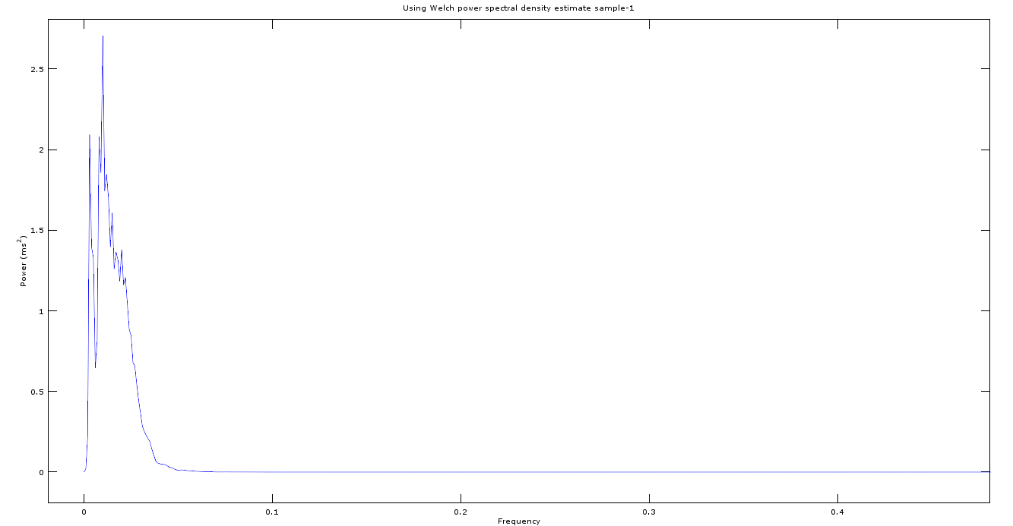
PSD OF RR INTERVAL SERIES

Slide 14
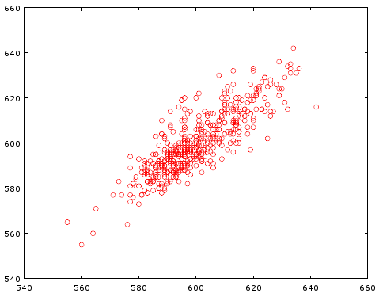
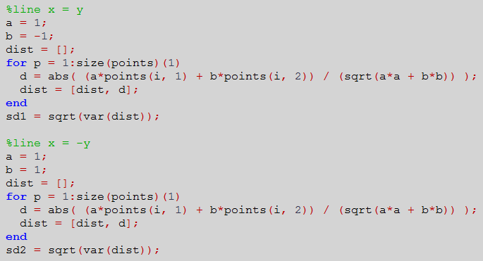
NON-LINEAR: POINCARE PLOT

Slide 15


NON LINEAR: APPROX & SAMPLE ENTROPY

Slide 16
FEATURES EXTRACTED
Time Domain
mean_rr, STD_rr, mean_hr, STD_hr, RMS_rr, rr_50, p_rr_50
Frequency Domain
pk_freq, abs_pow, rel_pow, norm_pow, LF_pow/HF_pow
Non-Linear
Poincare plot’s SD, ApEn, SamEn

Slide 17
FEATURES WHICH CAN BE EXTRACTED
Based on need as per classifier performance, following features can be added:
Time Domain
rr_hist, baseline_width_rr_hist
Frequency Domain
Sample Entropy – different ‘r’, ‘m’
Non-linear
DFA (Detrended Fluctuation Analysis), RPA (Recurrence Plot Analysis)

Slide 18
HARDWARE/CIRCUIT
Studied various circuit designs available to acquire ECG Signals
Met senior who had designed the circuit for his device
Simulated circuits designed using sample base designs provided in AD620 Data-sheet, as well as circuits used by senior.
Made modifications to circuit design as per requirements and issues faced.

Slide 19
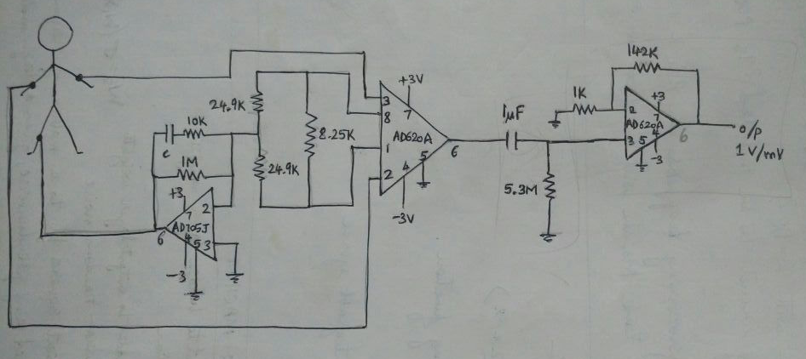
ECG CIRCUIT FROM AD620 DATASHEET
Simulated on MultiSim. The leg circuit to provide virtual ground did not work as expected.
Erroneous outputs resulted in abandoning the circuit for other options.

Slide 20
MODIFIED CIRCUIT
The circuit designed by senior was interfaced with a bluetooth module. We will not be using bluetooth.
It also contained an integrator circuit in the second stage. We did not understand the use of such a part of the circuit, and resulted in erroneous output.
Certain values of components(Resistors and Capacitors) were changed in order to obtain the necessary gain required.

Slide 21
OVERALL IDEA OF CIRCUIT
Virtual ground:
To provide a reference with respect to which the voltage at the fingertips can be measured.
The virtual ground will be provided to the thumb, so that the device can be hand held.
Instrumentation amplifier:
Used to measure the differential voltage between the two fingertips on both hands with respect to the virtual ground(thumb).
This stage provides most of the amplification.
Regular amp:
To provide secondary amplification after the instrumentation amplifier, i.e., to spread out the gains.

Slide 22
MODIFIED CIRCUIT
RG=249Ohm
G1=200
Voffset1=3.167mV
Voffset2=45.8mV
G2=5

Slide 23
CIRCUIT DESIGN FOR R-PI COMPATIBILITY
Max Differential I/P voltage=2.7mV
Leads to saturated output of 2.78V
Max I/P to each electrode=10.2mV
R-Pi does not have analog I/Ps
External ADC required(MPC3008)
10 bit ADC[0-1023]
R-Pi can take I/P from 0-3.3V
Resolution of R-Pi=3.22mV
If we increase supply voltage from 5V, we can increase range of I/P

Slide 24
CLASSIFIER
Found ELM documentation by developer.
Currently understanding ELM in order to implement it.
Algorithm:
W1 is the matrix of input-to-hidden-layer weights, σ is some activation function
W2 is the matrix of hidden-to-output-layer weights
Fill W1 with Gaussian random noise;
Estimate W2 by least-squares fit to a matrix of response variables Y, computed using the pseudoinverse, given a design matrix X:
Need to explore SVM
Additional classifers to explore
RVM
parametric and non-parametric models, System Identification

Slide 25
WORK DONE
RAKSHITH
Time domain feature extraction
Non linear feature extraction
APOORV
Raspberry pi setup
Frequency domain feature extraction
AKARSH
Circuit design/simulation
Introduction to ELM classifier

Slide 26
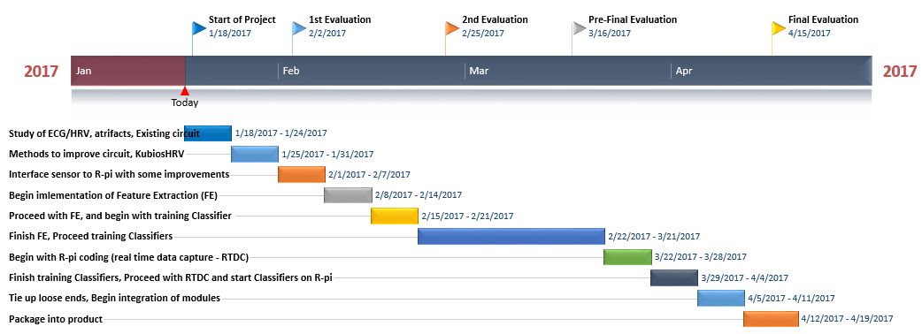
TIMELINE
On schedule as per expected timeline

Slide 27
TARGETS FOR THE NEXT REVIEW
RAKSHITH
Consolidate Features to CSV file
Explore SVM as a classifier
Construct and test circuit on breadboard
APOORV
Port all MATLAB code to R-PI to remove toolbox dependency
Construct and test circuit on breadboard
AKARSH
Train ELM classifier for consolidated features file
Construct and test circuit on breadboard

